Slide 1



ET Society
2024
Wrapped

Slide 2

EdTech Society
We now have
440 Members

Slide 3

EdTech Society
This year we conducted
01 Perspectives
02 Industry Talks
04 Infocus Interviews
04 Workshops
11 Masterclasses

Slide 4
EdTech Society
Partcipants of
NPTEL Workshops
312

Slide 5


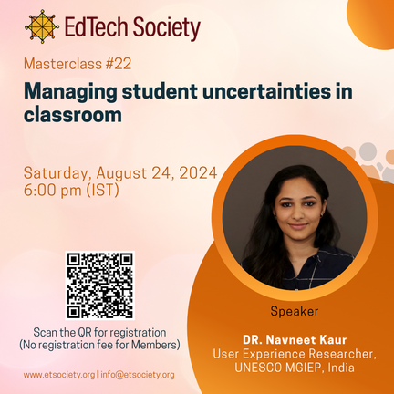

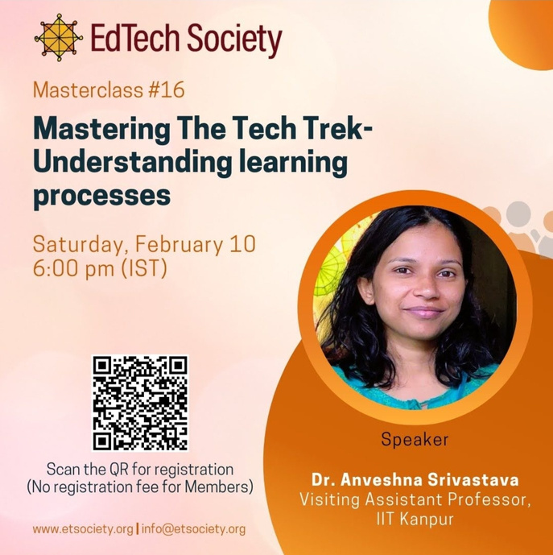







EdTech Society
Our Top Masterclasses
*
1
Mastering The Tech Trek- Understanding Learning Processes
2
Managing Student Uncertainties in Classroom
3
Designing Developing Deploying Online Courses on International Scale
Based on number of views
4
Scaling Education through People, Product and Organization
5
Scientific Design of Virtual Lab Experiment
*

Slide 6

EdTech Society
2024's
Top Genres
Edtech - Topping the charts
T4E+Compute - Live at IIT Gandhinagar
DETR (Edtech Society's Version)

Slide 7


EdTech Society
Featured
Member
Sagarika Prabhakar

Slide 8


Thank You!

